Slide 1
Predicting the Appearance of Cited Article on Social Media Site- YouTube
Priyanjani Chandra & Sneha Ravi Chandran Z1864520 Z1856678
3rd December, 2019

Slide 2
Content
What & why
Altmetrics Dataset
Data Cleansing
Correlation Matrix
Class Imbalance
Model
ROC and Precision- Recall curve
Challenges faced
Future work

Slide 3
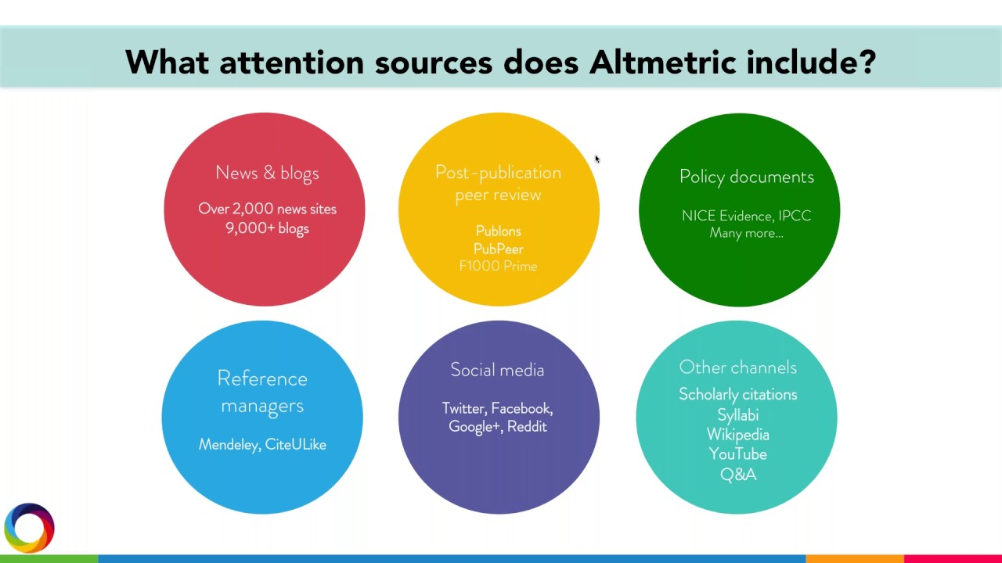
Altmetrics

Slide 4


What & Why?
To potentially identify whether any particular research paper is posted on the social media platform based on related feature selection from the chosen dataset
Collected the comprehensive details such as how the cited papers are being perceived amongst a group
How the viewers enjoy the content or how they are being used as a reference for other related research proposal
YouTube being one of the visually empowering web sources for any citation of scholarly articles.
Goal: To predict whether a research paper is cited in YouTube or not.

Slide 5
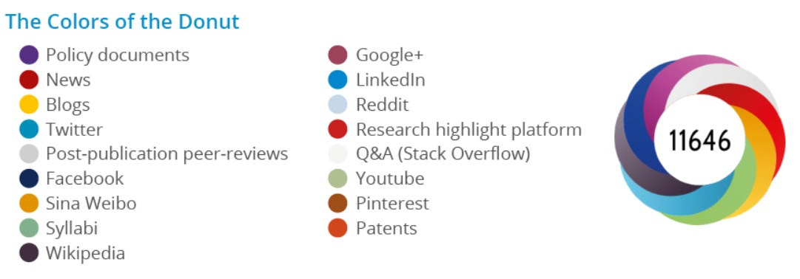
Altmetrics Dataset
Altmetric_sample_dataset: (100,000 samples) https://www.dropbox.com/sh/ezptabym0szfex3/AAAY30gQ5H3JE6qz3gH3_wqxa?dl=a&preview=altmetric_clean_sample.tar.gz
Altmetrics_dataset: (380,000 samples roughly) https://www.dropbox.com/sh/zcloke9egpomdza/AAD0IOQrtcw-yUZMVK56R8-za?dl=0

Slide 6
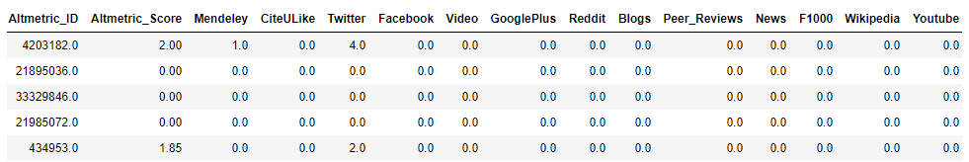
Data Cleansing
Performed on the sample altmetrics dataset to clean and store the data to the pandas dataframe
Extraction of JSON file and do feature selection and correspond it to the class labels
Class 0 : Not present in YouTube
Class 1 : Present in YouTube

Slide 7
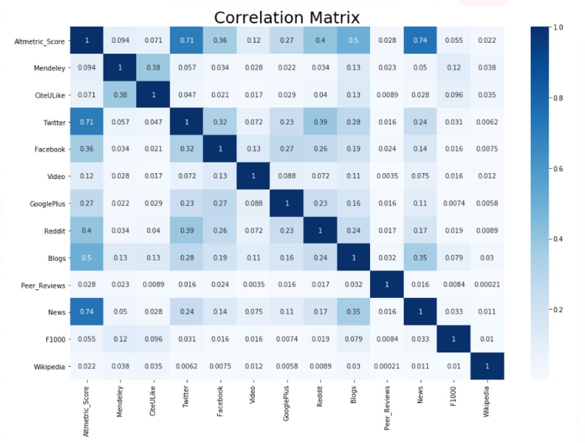
Correlation Matrix
After plotting correlation matrix we dropped Altmetric Score due to high correlation with the other features
As we progressed through the code we found that choosing video as one of the features was a wrong choice as it would it wrong results since it is highly correlated with that of the class label
7

Slide 8
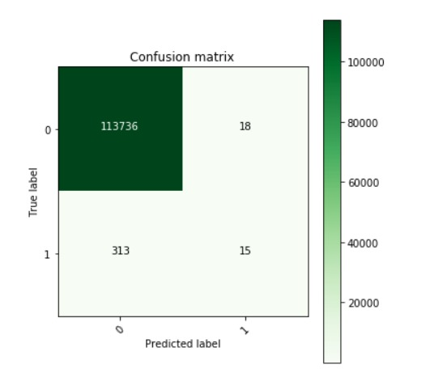
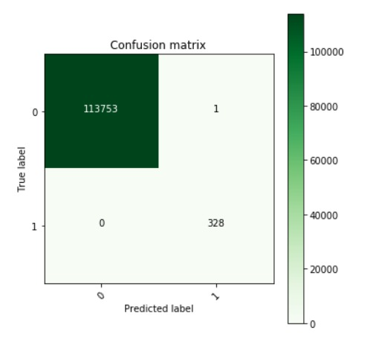
Contd..
Confusion matrix before and after removing Video column

Slide 9
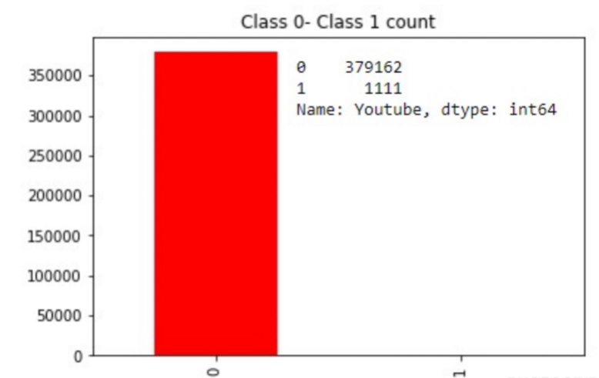
Class Imbalance
Our class was highly imbalance with total number of positive class were 1,111 and the total negative classes were 37,9162
To mitigate the class imbalance problem we used the below techniques
Over Sampling the minority class
Under Sampling the majority class
Synthetic Minority Over-sampling Technique- SMOTE
eXtreme Gradient Boosting- XGBoost

Slide 10
Models
Logistic Regression
Decision Tree Classifier
Random Forest
SVM

Slide 11
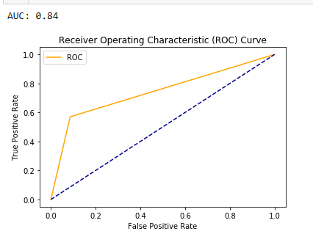
Receiver Operating Characteristic Curve
False Positive Rate (FPR) is plotted on the x-axis and True Positive Rate (TPR) is plotted on the y-axis. The FPR measures the fraction of negative examples that are misclassified as positive. The TPR measures the fraction of positive examples
that are correctly labelled.

Slide 12
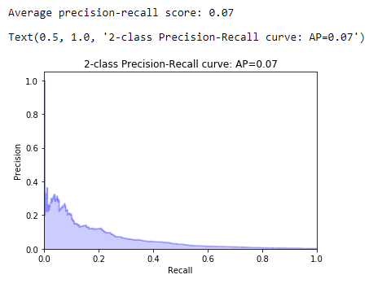
Precision- Recall Curve

Slide 13


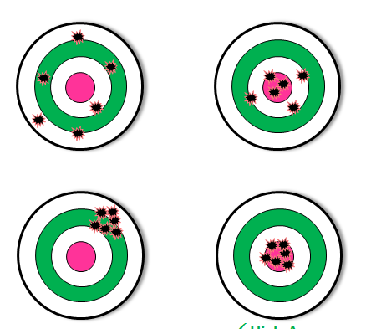
Challenges
Processing huge dataset
We began with a very high accuracy and had to trace back to find it we had any overfitting issues
SMOTE wasn’t in our favor
KNN took relatively a very loooooong time to run

Slide 14
Future work
We are looking at expanding the project to perform Regression on the YouTube dataset to calculate the likes and dislikes

Slide 15
Questions?

